Slide 1
Cognitive Modelling Workshop
May 30th, 2018
Kevin da Silva Castanheira

Slide 2
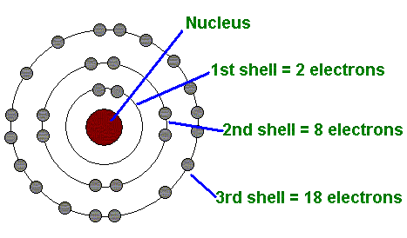
What is a computational model?
Model:
  Some form of abstraction that represents reality
  Help us understand reality
  E.g. Bohr-Rutherford model
Computational:
  Using a computer
  Nothing special about computers… you could use toilet paper and stones (Searle, 1980)
  Convenience, accuracy, power

Slide 3
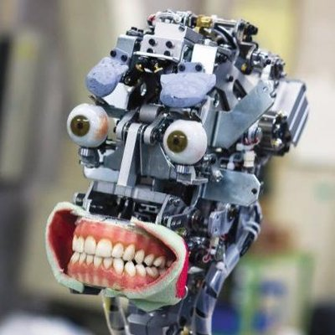
Why use Computational Models?
Think of the brain like a machine
  Sensory input & motor output
If you knew the blueprints to the “brain machine” you could:
  Take it apart and put it back together
  Fix it when it’s broken
  Predict what modifications will do to it
  Predict what output you’d get for a given input

Slide 4
Brain/Machine
You can try to understand the brain/machine at different levels
  Knowing what the machine is doing
  Knowing what operations the machine is doing
  Knowing how the machine is carrying out those operations

Slide 5
Marr’s Three levels of analysis
Computational
  What is the goal of the computation, why is it appropriate, and what is the logic of the strategy by which it can be carried out?
Representational / Algorithmic
  How can this computational theory be implemented? In particular, what is the representation of for the inputs and outputs, and what is the algorithm for the transformation?
Hardware Implementation
  How can the representation and algorithm be realized physically?
Notes:
Marr, D. C. (1982). A computational investigation into the human representation and processing of visual information. Free-man, San Francisco, CA.

Slide 6
Steps to making a Computational Model
Step 1: Reformulate the conceptual framework in terms of rigorous mathematical or computer language (code) description
Step 2: Make additional assumptions necessary not included in the conceptual framework (ad hoc assumptions)
Step 3: Estimate values for the coefficients, parameters
Step 4: Compare the predictions of your model to competing models. Which one produces results closets to the empirical data?
  Design experiments to test opposing predictions of the models
Step 5: Reformulate framework and start all over again!
Busemeyer
Notes:
http://facweb.cti.depaul.edu/mobasher/classes/HON207/Readings/cognitive-modeling.pdf

Slide 7
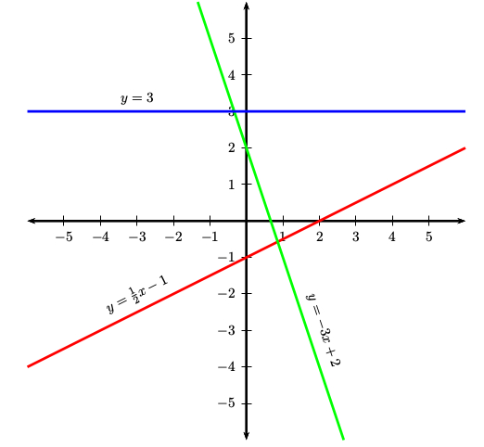
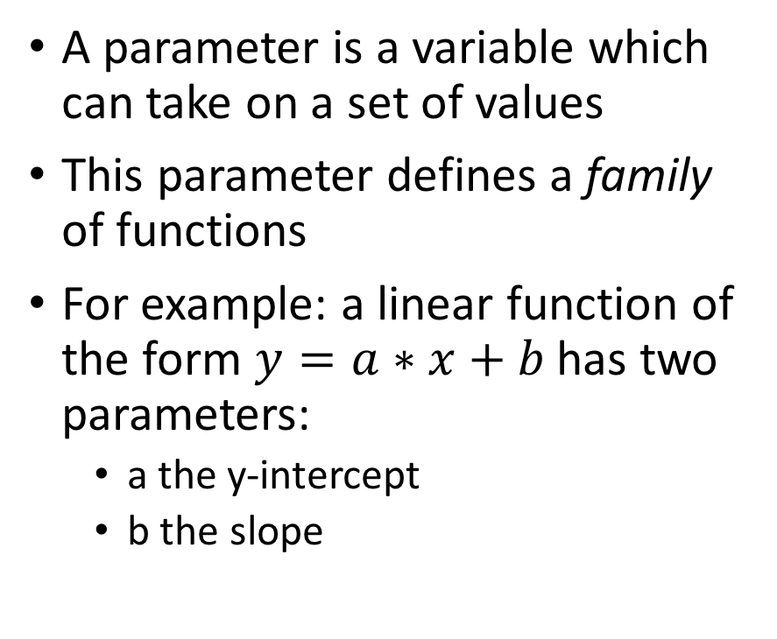
Parameter
A parameter is a variable which can take on a set of values
This parameter defines a family of functions
For example: a linear function of the form $y=a∗x+b$ has two parameters:
  a the y-intercept
  b the slope

Slide 8
Limitations & Concerns

Slide 9
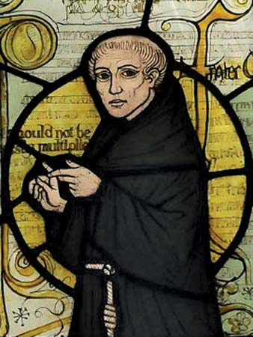
Occam’s Razor
“Plurality should not be posited without necessity.”
Heuristic for the development of scientific models
  Parsimonious
  Falsifiable
  Related to Overfitting

Slide 10
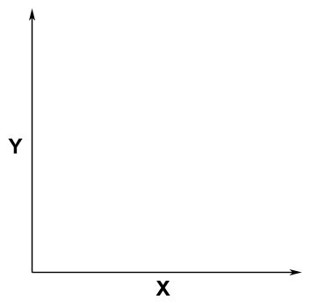
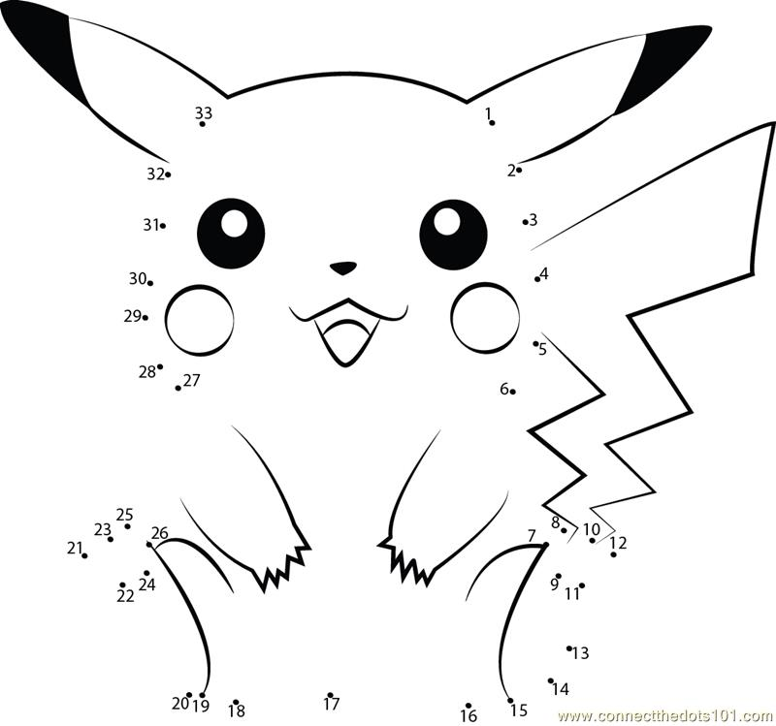
Overfitting
$$Y=βX+α$$
$$Y=βX^{2}+γX+α$$
$$Y=βX^{2}+γX+\frac{ξ\sin\left(τ\left(\sqrt{X}−φ\right)\right)}{\sqrt[3]{e^{−ωX}}} +α$$

Slide 11
Avoiding Overfitting
Collect more data and see if your model still fits
Have a model selection criteria which punishes free parameters
  Remember that models with more parameters are more “flexible” and can fit data better not because they’re theoretically explaining some phenomenon but because they’re being influenced by the noise

Slide 12
Expected Utility Theory
Normative Model of Decision-Making

Slide 13

St. Petersburg Paradox
How much would you pay to play the following game?
I flip a coin an indefinite number of times. If it’s heads you win, if tails you lose. With every flip of the coin, I double the pot.
WOW! You’re on a roll, Cady! How much did you win?
The limit does not exist!!
 | $2 | $4 | $8 | … | $$2^{n}$
 | H/T | H/T | H/T | … | H/T
total | $2 | $6 | $14 | … | $$$$

Slide 14
St. Petersburg Paradox
The average expect earnings of a player is infinite!!!
BUT people are only willing to pay ~ $1 - $2 to play
Why?

Slide 15



What is Utility?
Utility: Value, benefit, function, profit, use of something
  Not absolute! (Context dependent)
Decisions are ultimately about comparing utility
The Expected Utility is the average Utility you expect to get if you made that choice many many times

Slide 16
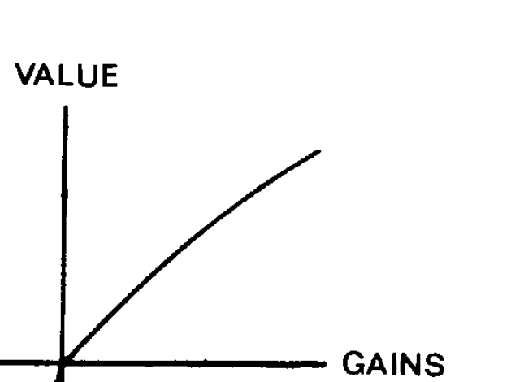
Expected Utility Theory
Utility: the benefit from consuming a product
Diminishing Marginal Utility:
  $ 1,000,001 - $1 M < $2 - $1
The value of a lottery can be calculated by multiplying the probability of winning to the SUBJECTIVE value (utility) gained
Choose the lottery with the highest expected utility

Slide 17
Problems with Expected Utility Theory
This is a normative model of decision-making (what you ought to do)
When observing how people act, there seems to be a few anomalies which cannot be explained by Expected Utility theory:
  Framing Effects: Losses & Gains are not psychologically equivalent
  Probability Weighting: Humans do not treat probabilities objectively

Slide 18
Prospect Theory
Descriptive Model of Risk Preferences

Slide 19
Fourfold Pattern of Risk Preferences
 | Losses | Gains
High Probability | Risk Seeking | Risk Averse
Low Probability | Risk Averse | Risk Seeking

Slide 20
Prospect theory
Kahneman & Tversky 1979; 1992
Won the Nobel prize in Economics (2002)
Mathematical Descriptive Model of Human Choice
Contributions:
  Shape of Utility Function (Framing)
  Probability weighting

Slide 21
Prospect Theory
Utility
Losses
Gains
$$U\left(6000\right)<U\left(4000\right)+U(2000)$$
$$U\left(−6000\right)>U\left(−4000\right)+U(−2000)$$

Slide 22
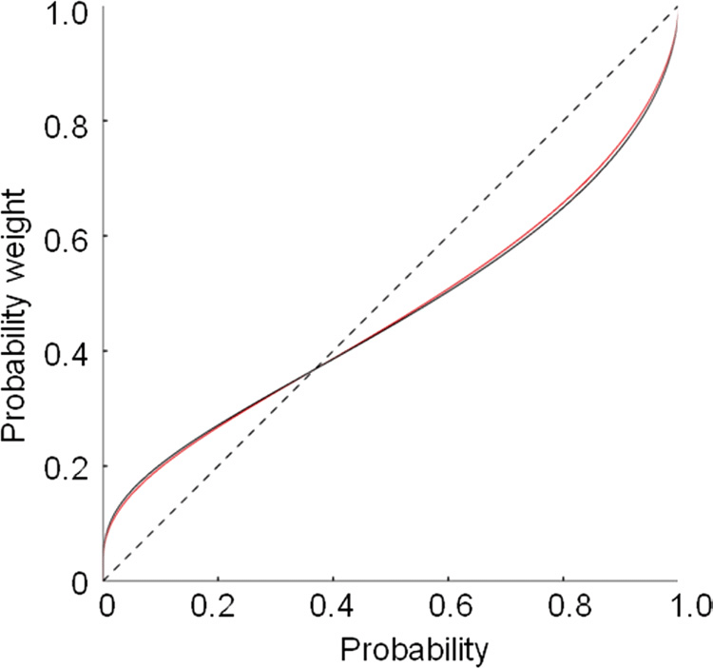
Probability Weighting Function
Probabilities are not treated objectively
Extreme events tend to be rare
Related to availability:
    What’s more common, dying in a car crash or dying of cancer?
    Extremity of event related to perceived probability
  Extreme events tend to be perceived as more common
  Mundane events tend to be perceived as less common
Notes:
1 in 7 people die from cancer but 1 in 88 people die in motor vehicle accients

Slide 23
Prospect Theory
Compute the utility of each option
Compute the subjective probability of each outcome
Sum the products across outcomes for each prospect
Compare the two prospects: sign of $∆U$ will tell you what you should pick
A | B
$1M with 0.01% | $1 with 100%
$0 with 99.99%
$$π\left(0.01\right)∗U\left(1M\right)+ π\left(99.99\right)∗U(0)$$ | $$π\left(100\right)∗U\left(1\right)$$

Slide 24
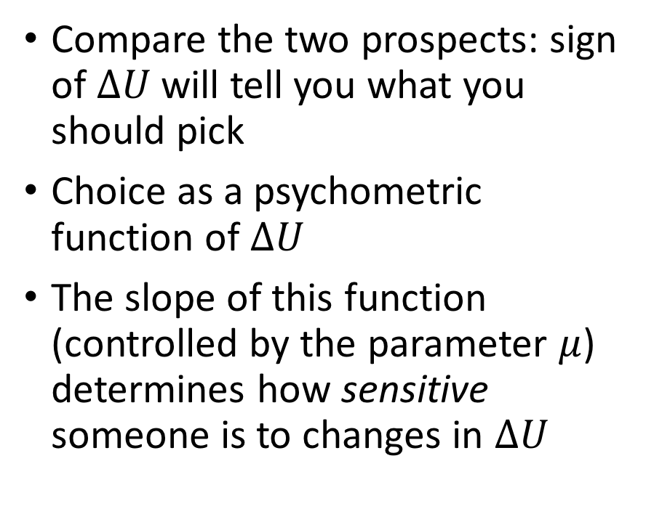
Choice
Compare the two prospects: sign of $∆U$ will tell you what you should pick
Choice as a psychometric function of $∆U$
The slope of this function (controlled by the parameter $μ$) determines how sensitive someone is to changes in $∆U$

Slide 25
Maximum Likelihood Estimation

Slide 26
Likelihood vs. Probability
Probability: is the plausibility of a future event (i.e. Will this happen?)
Likelihood: is the plausibility of a parameterization given observed data (i.e. Do these parameters explain what happened?)
Maximum likelihood: find the parameters that maximize the likelihood
Likelihood would be the product of the model’s predicted probability of every event

Slide 27
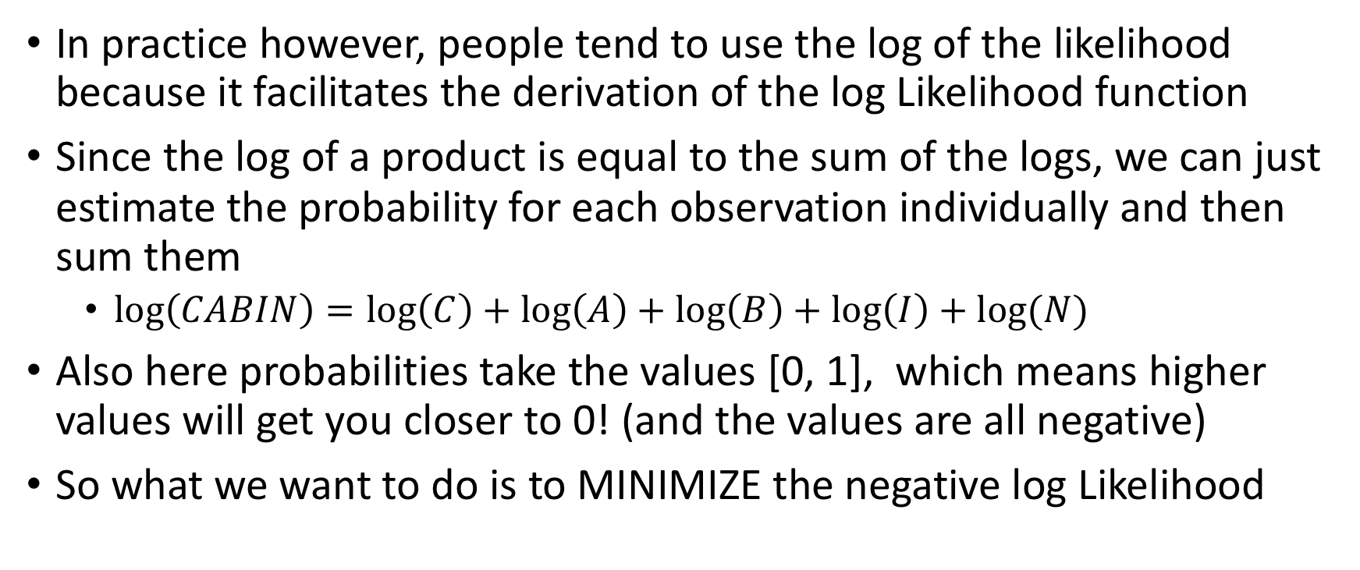
Log Likelihood
In practice however, people tend to use the log of the likelihood because it facilitates the derivation of the log Likelihood function
Since the log of a product is equal to the sum of the logs, we can just estimate the probability for each observation individually and then sum them
  $\log\left(CABIN\right)=\log\left(C\right)+\log\left(A\right)+\log\left(B\right)+\log\left(I\right)+log⁡(N)$
Also here probabilities take the values [0, 1], which means higher values will get you closer to 0! (and the values are all negative)
So what we want to do is to MINIMIZE the negative log Likelihood

Slide 28
Data Analysis

Slide 29



Hypothesis
Does wearing Designer shirts makes you place more utility on larger sums of money?
Condition 1: Designer Shirt
Condition 2: Cheap Shirt

Slide 30
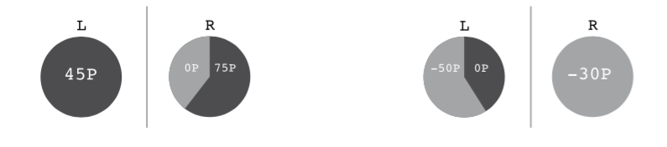
Task

Slide 31
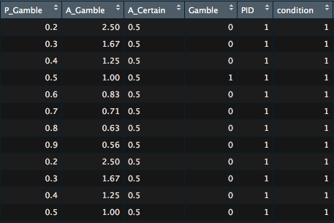
Data
P_Gamble: probability of the gamble
A_Gamble: Amount of $ for the Gamble
A_Certain: Amount of $ for the certain option
PID: Participant ID
Condition: Experimental condition

Slide 32
GitHub:
https://github.com/kcastanheira/Cog_modelling_tutorial

